Slide 1
Human capital relatedness and mergers and acquisitions
Kyeong Hun Lee
David C. Mauer
Emma Qianying Xu
Journal of Financial Economics
March 2018
Presented by: Yan Li

Slide 2
Research Question:
Does human capital relatedness encourage mergers and create synergies?

Slide 3
Hypotheses
Hypothesis 1 . The likelihood of two firms merging is increasing in the relatedness of their human capital.
Hypothesis 2 . The gains from merger are increasing in the relatedness of merging firms’ human capital.
Hypothesis 3. Post-merger employment and wages are decreasing and labor productivity increasing in the relatedness of merging firms’ human capital

Slide 4
Data and Variables
Thompson Financial Securities Data Company (SDC) database: US domestic mergers and acquisitions (M&A)
Compustat: financial statement
Center for Research in Security Prices (CRSP): stock returns
The OES program of the BLS, and Compustat Industry Segment (CIS) database: the industry occupation data to contruct human capital measure.
Sample: 1474 M&A deals
Sample Period: from 1997 to 2012

Slide 5
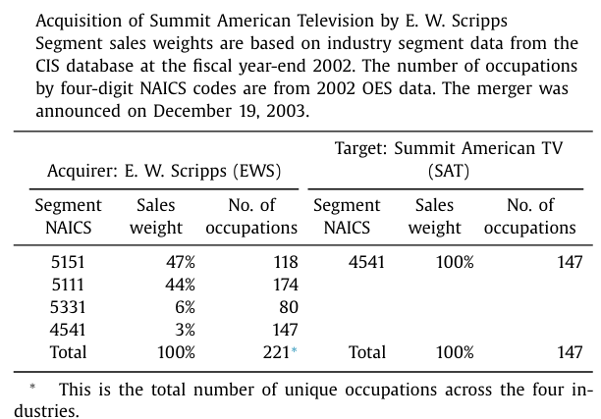

Human capital relatedness
Human capital relatedness
Human Capital Profile Vector of Acquirer A: H _{A}
Human Capital Profile Vector of Target T: H _{T}
Graphic Designer: The percentage of employees working in this occupation in EWS’s industry segments (NAICS codes 5151, 5111, 5331, and 4541) are 0.38%, 3.03%, 0.88%, and 0.70%, respectively. Using segment sales weights, the graphic designer element in H EWS is computed as (0.47)(0.38%) + (0.44)(3.03%) + (0.06)(0.88%) + (0.03)(0.70%) = 1.59%.
Notes:
We construct a measure of human capital relatedness between merging firms A (acquirer) and T (target) using the angular separation (or uncentered correlation) of their human capital profile vectors H _{A} and H _{T} (see, e.g., Jaffe, 1986 ). Specifically, human capital relatedness, HCR , is computed as the scalar product of the merging firms’ human capital profile vectors divided by the product of their lengths. HCR is bounded between zero and one; it is zero for merging firms whose human capital profile vectors are orthogonal and unity for merging firms whose human capital profile vectors are identical. Importantly, it is closer to unity for merging firms with more related human capital.

Slide 6
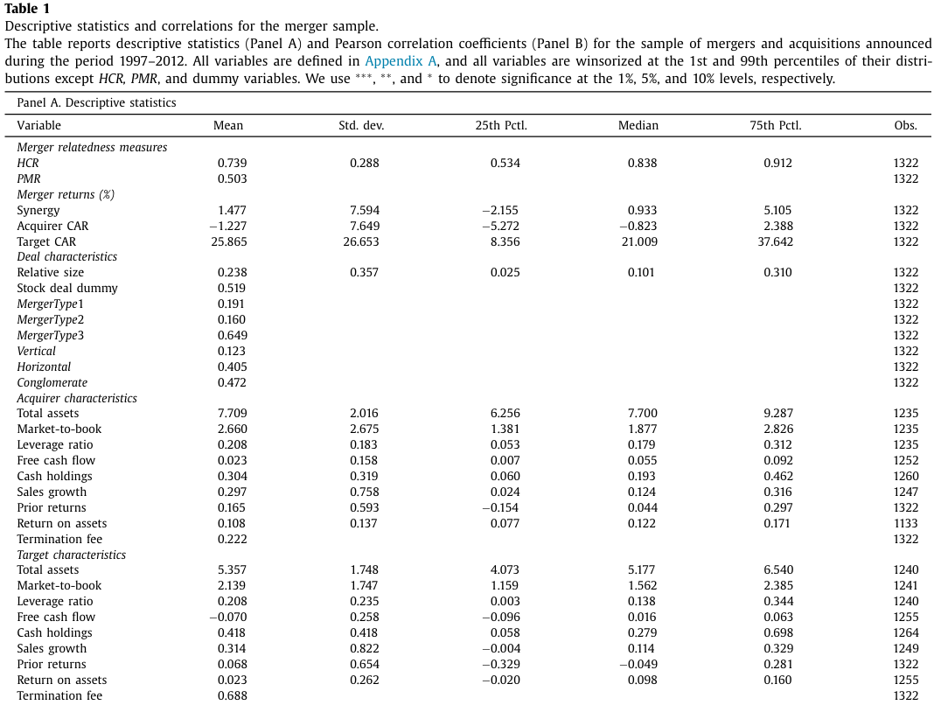
Descriptive Statistics for the Sample
MergerType 1 (19%): mergers between single segment firms in different industries
MergerType 2(16%): mergers where one or both acquirer and target have multiple segments
MergerType 3(65%): at least one segment in the same industry
Notes:
- 12% of the acquisitions in our sample are vertical, 41% are horizontal, and 47% are conglomerate.
- The mean (median) HCR of 0.74 (0.84) suggests that the typical merger in the sample has high human capital relatedness, suggesting that human capital relatedness is an important factor in mergers. More than 50% of sample mergers have high product market relatedness ( PMR = 1).
- Synergy , is positive (1.48%), indicating that acquisitions, on average, create wealth.
- The acquiring firm has larger mean and median market-to-book ratio, free cash flow, stock returns prior to the deal, and return on assets

Slide 7
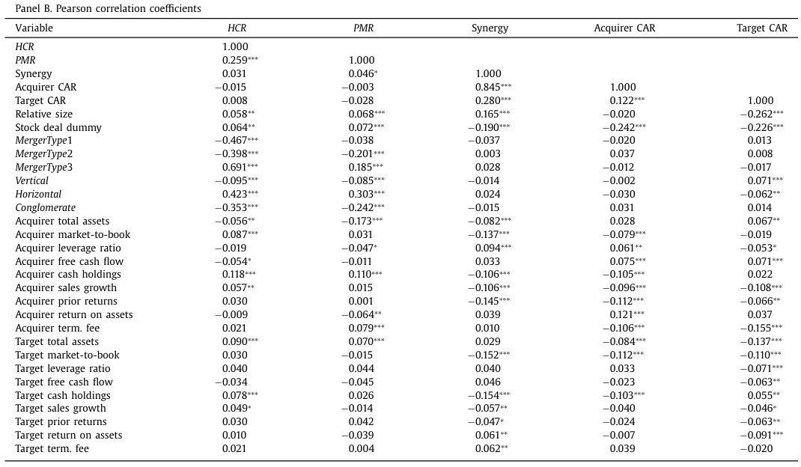
Descriptive Statistics for the Sample
Notes:
The correlation between HCR and PMR is positive (0.26). This is intuitive, as a high degree of product similarity likely maps into many similar job titles. The correlations between HCR and PMR and merger types are consistently positive when merging firms have overlapping industries (i.e., MergerType 3 and Horizontal ) and negative when merging firms are in unrelated industries (i.e., MergerType 1, MergerType 2, Vertical , and Conglomerate ). There is less evidence, however, that HCR and PMR are related to merger returns, since neither measure is related to acquirer or target returns, and the correlations with the combined return ( Synergy ) are positive, but quite modest.

Slide 8
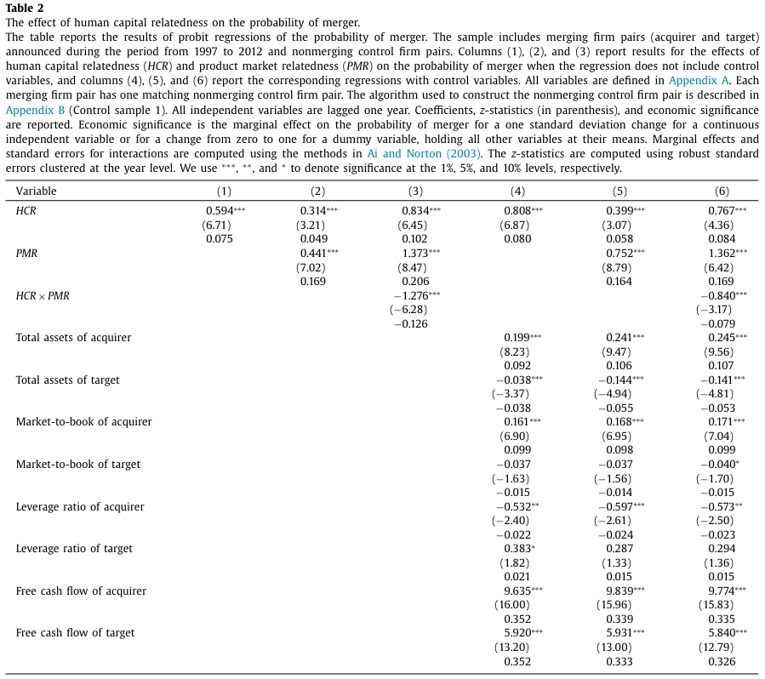
Predicting mergers
Notes:
Regressions (4)–(6) are identical except they include all of the deal and firm characteristic control variables.
The positive coefficients on HCR in Table 2 confirm that human capital relatedness increases the likelihood of merger.
Product market relatedness also contributes significantly to the likelihood of merger, as the coefficients on PMR in regressions (2), (3), (5), and (6) are positive and highly statistically and economically significant. Interestingly, the coefficients on HCR ×PMR in regressions (3) and (6) are significantly negative, revealing that high product market relatedness ( PMR = 1) mitigates the positive effect of HCR on the likelihood of merger.

Slide 9
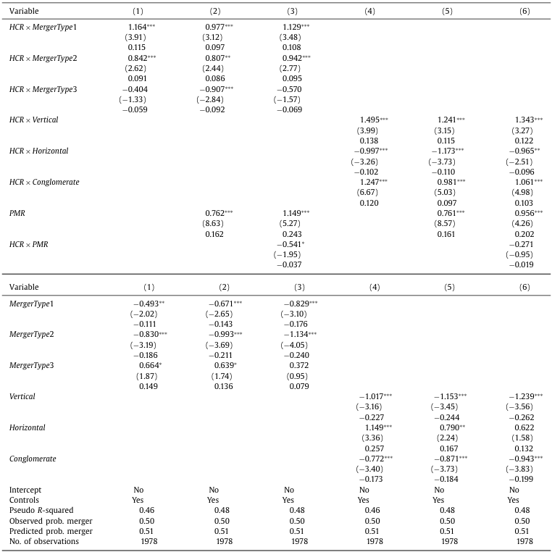
Predicting mergers
T3 examines the influence of merger type on the relation between human capital relatedness and the probability of merger.
Notes:
the coefficients on the interactions of HCR and MergerType 1 and MergerType 2 are positive, while the coefficients on the interactions of HCR and MergerType 3 are negative. The implication is that human capital relatedness predicts mergers of unrelated firms, but not related firms.
the likelihood of vertical and conglomerate mergers is increasing in HCR , while the likelihood of horizontal mergers is decreasing in HCR . These findings are consistent with the negative effect of HCR ×PMR on the likelihood of merger in Table 2
When firms are related along product market dimensions, human capital relatedness can discourage mergers because employee incentives are lower due to a decrease in competition for their services within the industry/product market.

Slide 10
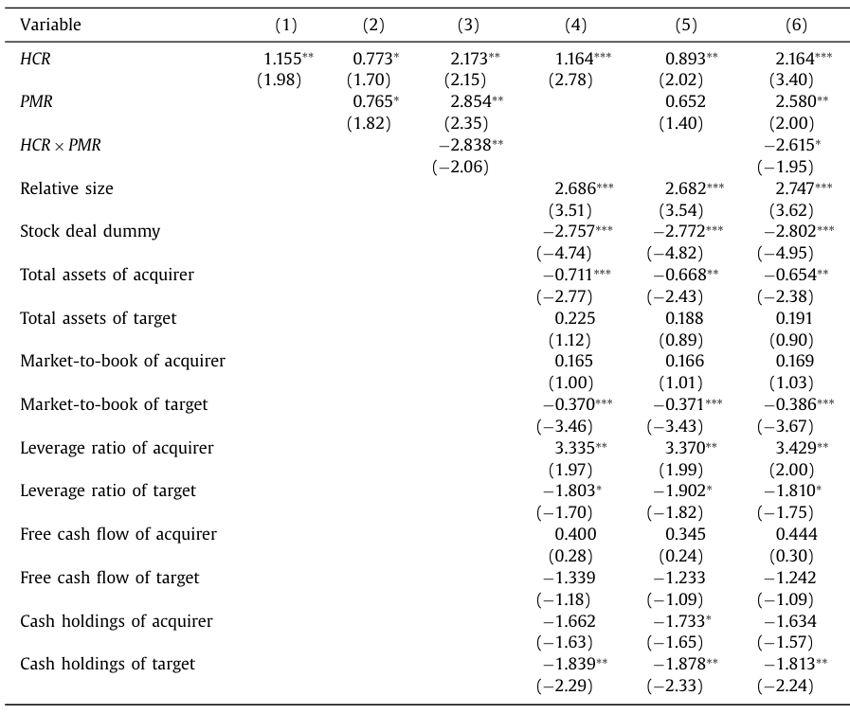
Merger synergy
Table 4 The effect of human capital relatedness on the gains from merger.
Notes:
HCR has a significantly positive effect on Synergy
The statistical significance of the coefficient estimate on HCR only takes a small hit when PMR is added to the specification and significantly improves when in turn HCR ×PMR and the control variables are added to the specification
The regressions provide solid support for the prediction that human capital relatedness increases the synergy gains from merger
Merger synergy is decreasing in the size of the acquirer, target market-to-book, target leverage, prior returns of the acquirer, and whether the deal is stock financed; merger synergy is increasing in the relative size of the target and acquirer leverage. The negative coefficient on target cash is consistent with the probit result that target cash decreases the likelihood of acquisition because a large cash stockpile allows the target to deter the acquisition

Slide 11
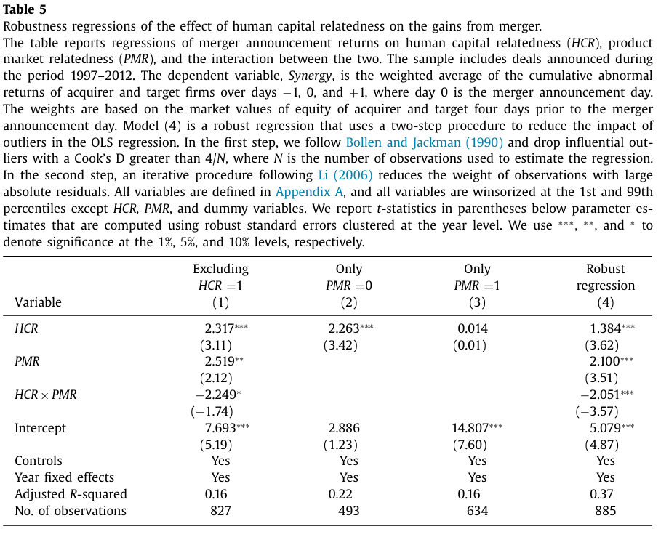
Merger synergy
Notes:
Column 1: Excluding these observations with HCR = 1 has no effect on the results; the main effects of HCR and PMR are positive, and their interaction is negative.
Column 2 and 3: The effect of HCR on Synergy is positive when PMR = 0 and zero when PMR = 1.
Regression (4) is a robust regression that uses a two-step procedure to reduce the impact of outliers on the estimated coefficients. In the first step, drop influential outliers. In the second step, reduces the weight of observations with large absolute residuals. The coefficients on HCR and PMR are smaller—by 40% and 17%, respectively—but continue to be statistically and economically significant.

Slide 12
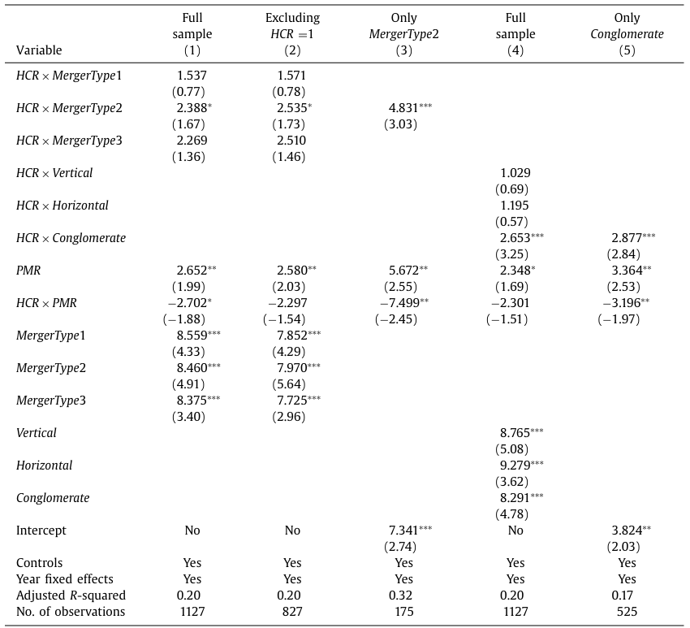
Merger synergy
Table 6 The influence of merger type on the effect of human capital relatedness on the gains from merger.
Notes:
The coefficients on the interactions in regression (1) are positive, but only the one on HCR ×MergerType 2 is significant. Excluding mergers where HCR = 1 (i.e., single segment merging firms in the same industry) in regression (2) produces virtually identical results. In regressions using merger-type subsamples, we find that mergers classified as MergerType 2 are the only ones with a significantly positive coefficient on HCR as reported in (3). The regressions in (4) and (5) similarly show that HCR has a significantly positive effect on Synergy only in unrelated ( Conglomerate ) mergers.
Human capital relatedness is less valuable in horizontal mergers or mergers between firms operating in similar product markets, because mergers between firms operating in the same product market(s) decrease labor competition, which reduces the value of a worker’s outside options and negatively effects wages and incentives

Slide 13
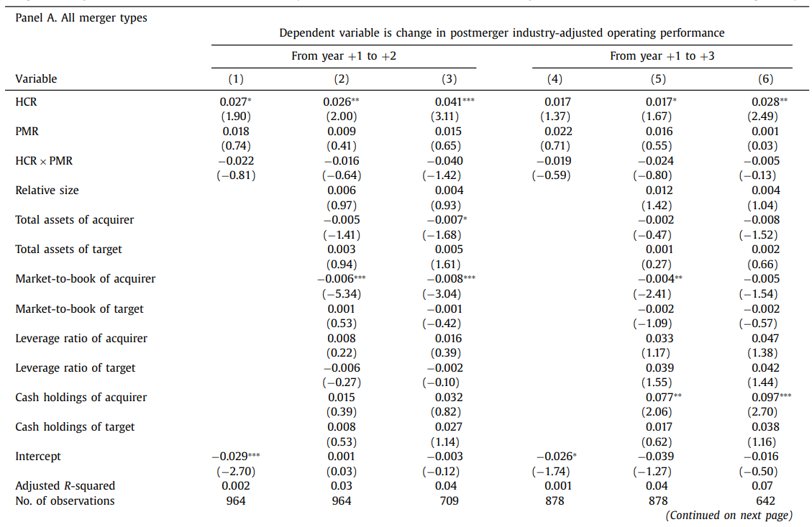
Post-merger outcomes - Operating performance
Table 7 The effect of human capital relatedness on post-merger operating performance.
Industry-adjusted operating performance is the difference between a firm’s operating performance and the median operating performance of firms in the same three digit SIC code.
Regressions (3) and (6) exclude mergers between single segment firms in the same industry (i.e., cases in which HCR =1)
Notes:
The coefficients on HCR in Panel A are significantly positive, confirming that human capital relatedness predicts post-merger operating performance. The coefficients on PMR and the interaction between HCR and PMR, however, are never significantly different from zero

Slide 14
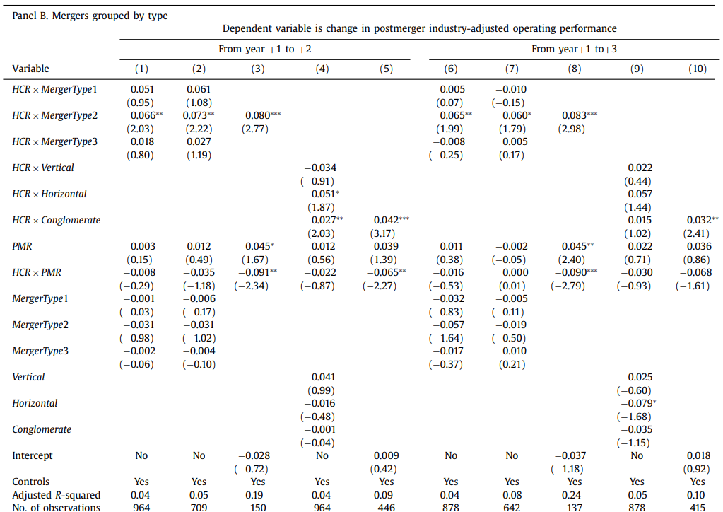
Post-merger outcomes - Operating performance
Table 7 The effect of human capital relatedness on post-merger operating performance.
Notes:
Panel B confirms that the positive relation between HCR and post-merger operating performance is largely driven by unrelated acquisitions (MergerType2 and Conglomerate), consistent with the results that both the likelihood of merger and returns from merger are significantly higher for unrelated acquisitions.

Slide 15
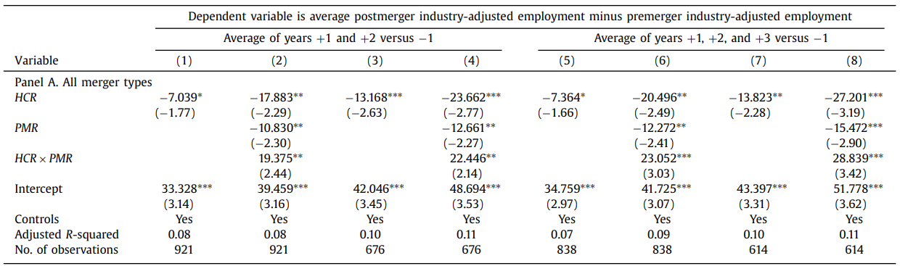
Post-merger - . Changes in employment, wages, and labor productivity
Table 8 The effect of human capital relatedness on post-merger change in employment
The dependent variable is the average post-merger industry-adjusted number of employees in years +1 and +2 (or +1, +2, and +3) minus the premerger industry-adjusted number of employees in year −1, where year 0 is the merger announcement year.
Regressions (3), (4), (7), and (8) exclude mergers between single segment firms in the same industry (i.e., cases in which HCR = 1)
Notes:
The coefficient on HCR is significantly negative in all regressions reported in Panel A, indicating that human capital relatedness predicts lower post-merger employment. The negative relation is stronger when the regression includes PMR and excludes mergers where HCR = 1. In the regressions, the coefficient on PMR is also negative, and the coefficient on HCR × PMR is positive. Thus, product market relatedness also decreases postmerger employment, and the negative effect of human capital relatedness on postmerger employment is attenuated in mergers with a high degree of product market

Slide 16
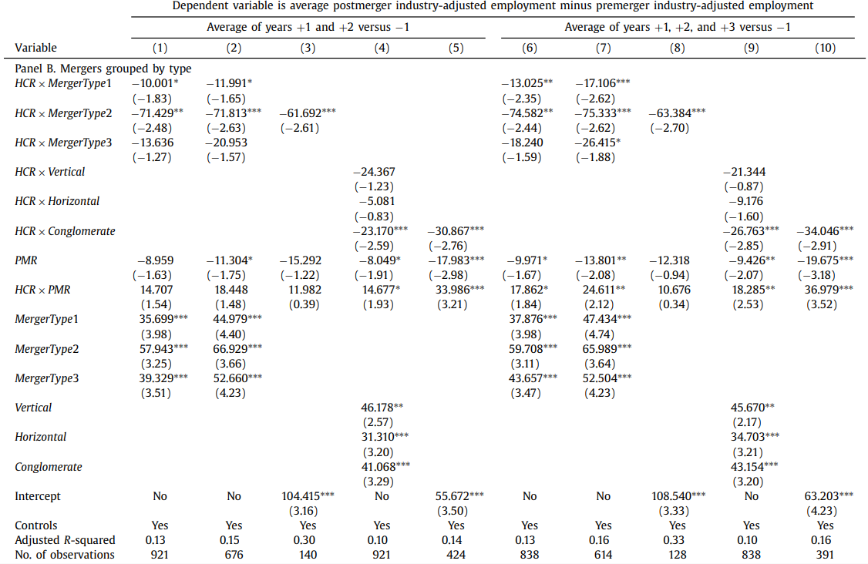
Post-merger - . Changes in employment, wages, and labor productivity
Table 8 The effect of human capital relatedness on post-merger change in employment
Notes:
The negative effect of HCR on post-merger employment is significant only in unrelated acquisitions (i.e., MergerType1, MergerType2, and Conglomerate mergers. In contrast, there is not a significant change in employment for related acquisitions (i.e., MergerType3, Vertical, and especially Horizontal mergers)

Slide 17
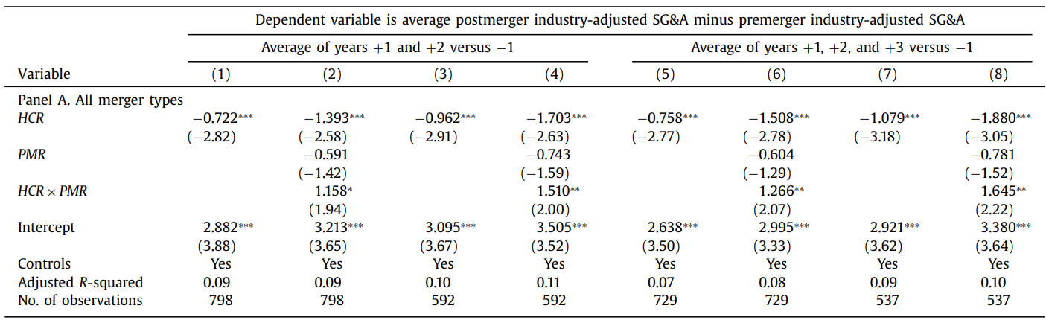
Post-merger - . Changes in employment, wages, and labor productivity
Table 9 The effect of human capital relatedness on postmerger change in selling, general, and administrative expense.
Notes:
in Panel A that HCR predicts lower post-merger labor expense

Slide 18
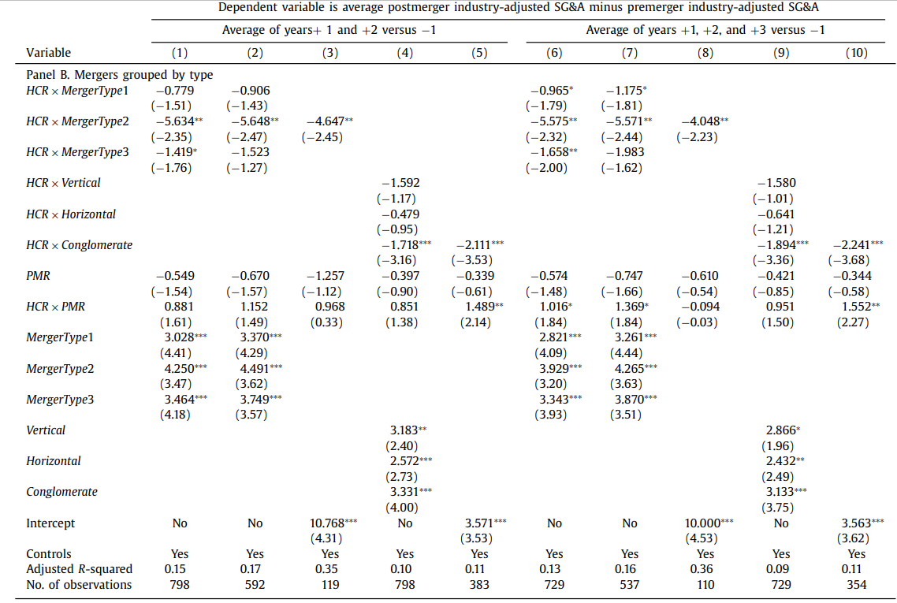
Post-merger - . Changes in employment, wages, and labor productivity
Table 9 The effect of human capital relatedness on postmerger change in selling, general, and administrative expense.
Notes:
The decrease in post-merger SG&A is primarily driven by unrelated mergers and appears to be highly economically significant.
The evidence in Tables 8 and 9 suggests that cost reductions through lower employment and wages are an important channel through which human capital relatedness enhances the performance of unrelated mergers. In contrast, there is no evidence that mergers between firms with a high degree of industry overlap and/or product market relatedness predict lower employment and wages.

Slide 19
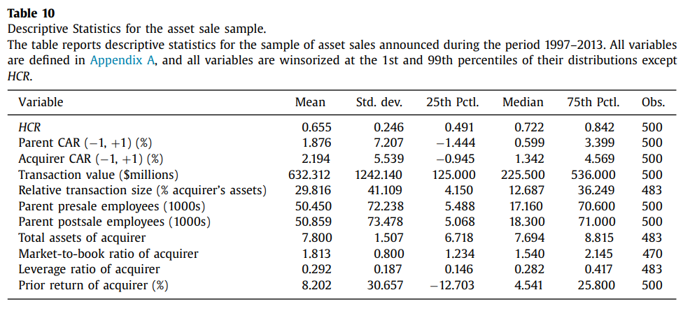
A falsification test -Asset sales
Notes:
The idea is that the acquisition of an asset differs fundamentally from the merger of two firms in that human capital may not be transferred from the selling firm (parent) to the acquiring firm

Slide 20
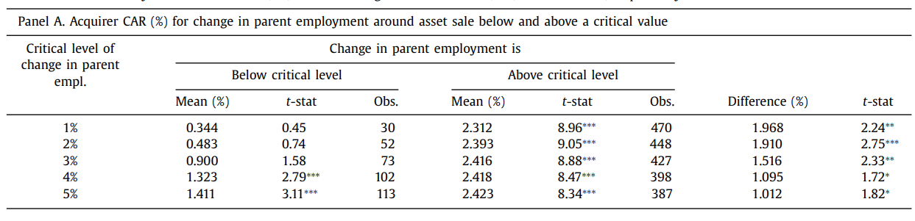
A falsification test -Asset sales
Table 11 Acquirer returns in asset sales and parent employee transfer
Falsification Test: the gains from merger are unlikely to be causally related to human capital relatedness if HCR predicts the gains to acquirers in asset sales when there is little or no transfer of employees.
Notes:
in Panel A that for critical levels of the change in parent employment ranging from 1% to 5%, the acquiring firm announcement return is always significantly smaller for the subsample below the critical level than for the subsample above the critical level. This supports rejection of falsification in that acquiring firm gains from asset acquisitions are economically and statistically smaller when there is not a significant human capital component to the transaction

Slide 21
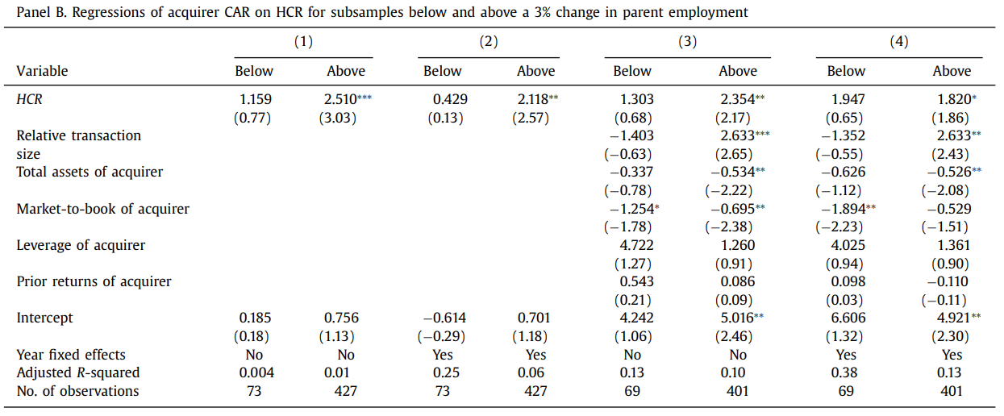
A falsification test -Asset sales
Table 11 Acquirer returns in asset sales and parent employee transfer
Notes:
Although the coefficients on HCR in the below 3% change in employment subsample are positive, they are not statistically significant. In contrast, the coefficients on HCR are significantly positive in the above 3% change in employment subsample, where there is more likely to be a nontrivial transfer of human capital in the asset sale.

Slide 22
Conclusions
The likelihood of merger is increasing in human capital relatedness
Announcement returns and post-merger operating performance are higher when merging firms have closely related human capital
The benefits from combining firms with complementary human capital accrue primarily to diversifying acquisitions
A merger of firms with high human capital relatedness predicts a reduction in post-merger employment and labor costs

Slide 23
Thank you!

